Slide 1
West Lake Landfill CommUnity Meeting July 17, 2014
Thanks to the International Union of Operating Engineers Local 513 for providing free space for these important community meetings.
#WestLakeLandfill
#BridgetonLandfill
Notes:
Unity, unity, unity

Slide 2
Franciscan Sisters of Mary

Slide 3
Just Moms STL

Slide 4
Report Odor Alerts email: swmp@dnr.mo.gov Call: 800-361-4827 or 573-751-5401 - Fax: 800-526-3902 or Fill out the Odor form @ http://www.dnr.mo.gov/bridgeton/concern.htm

Slide 5
Fundraising Update

Slide 6
How did nuclear weapons related radioactive wastes end up at West Lake?
1942: The Manhattan Project and Mallinckrodt
1946-1957: Wastes stored at the airport along Coldwater Creek
1966-1967: Wastes moved from airport to Latty Ave in Hazelwood
1973: Wastes moved from Latty Ave. to West Lake Landfill
1974: Radioactive sections of landfill closed.
1990: West Lake put on EPA National Priorities List
2008: EPA decided to cap-and-leave radioactive wastes
2010: EPA reopened and reevaluating decision, which is ongoing
2010: Smoldering landfill fire started
2013: Attorney General sues Republic Services
2014: Attorney General request radioactive testing outside of the Landfill and of the Haul Roads. The AG also set a Motion for Trial.

Slide 7
SB 731 Veto by Gov. Jay Nixon http://governor.mo.gov/sites/default/files/SB%20731%20veto.pdf

Slide 8
SB 731 Veto Continued

Slide 9
Veto Session: September 10, 2014

Slide 10
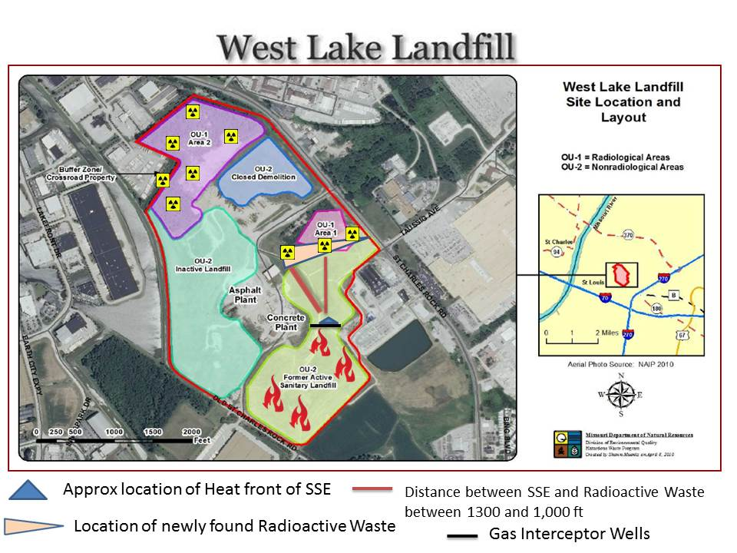
Smoldering Fire Update

Slide 11
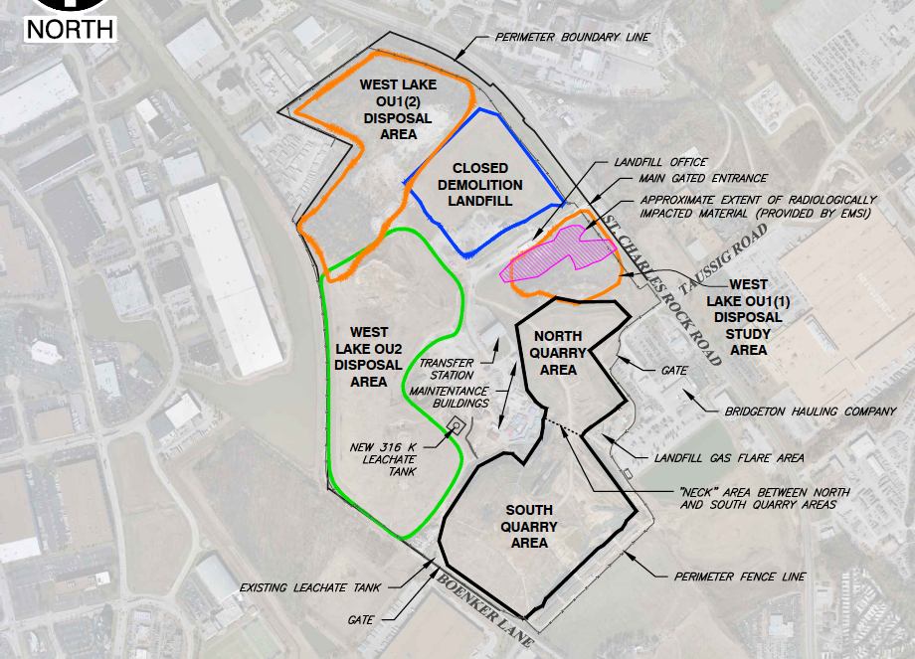
MDNR
Notes:
Bridgeton Landfill North Quarry Action Plan Rev 1/28/2014
http://www.dnr.mo.gov/bridgeton/

Slide 12
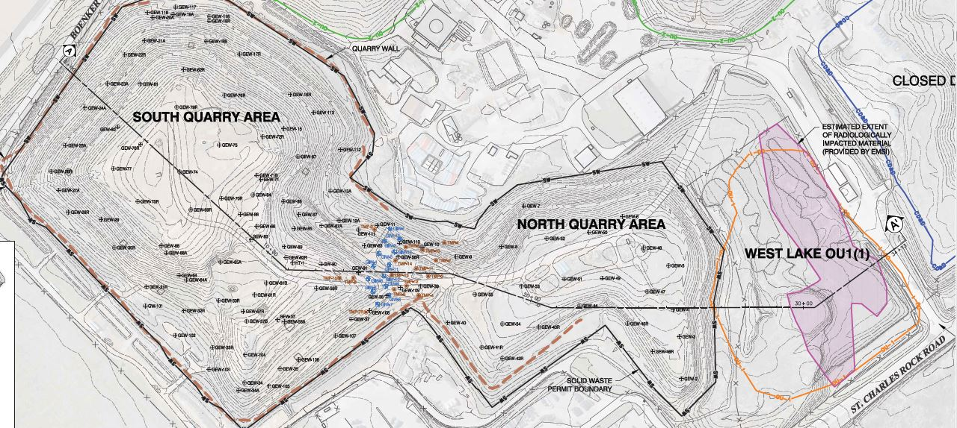
Notes:
August 13, 2013: Republic Services contingency plan map Figure-2

Slide 13
Smoldering Fire Update

Slide 14
Smoldering Fire Update

Slide 15
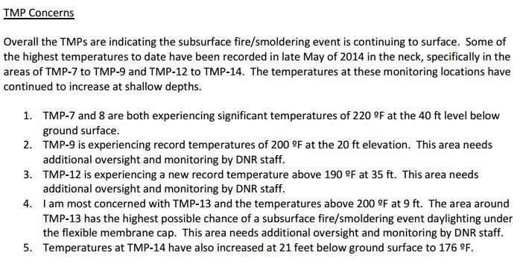
Smoldering Fire Update

Slide 16
New Source Performance Standards (NSPS)
1970 Clean Air Act Amendment requires EPA to develop technology-based standards for pollutant emissions.
Extraction wells in Municipal Solid Waste Landfills should be <131°F.
“For a specific site, the owner or operator may establish a higher temperature…with approval from the State.”
Elevated temperatures are an “indicator of subsurface fires and aerobic conditions within the landfill.”
Source: EPA, 1999
http://www.epa.gov/ttn/atw/landfill/lf-vol1.pdf

Slide 17
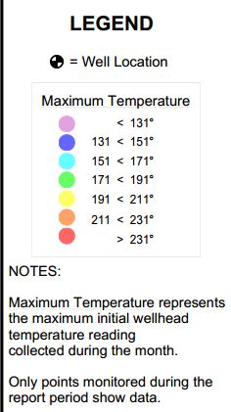
May: GEW 53-54 Between 134-138°F

Slide 18
GEWs in the South Quarry

Slide 19
National Institute for Occupational Safety and Health (NIOSH)
NIOSH is a part of the Centers for Disease Control.
Performed a Health Hazard Evaluation at the request of the International Association of Fire Fighters.
Find the report at: http://moenviron.org/images/NIOSH_WestLake_Web.pdf

Slide 20
NIOSH Review
The wastes at the landfill have been poorly defined (pg. 4)
Components being used to manage the smoldering landfill fire can become compromised due to the smoldering fire (pg. 4)
Radioactively Impacted Material (RIM) is believed to be limited to OU-1. NIOSH seems to agree that a comprehensive understanding of where the RIM is located does not exist (pg. 5)
DHSS is monitoring for "short-term health effects". No mention of long-term health impacts (pg. 5)
Carbon Monoxide in the Gas Extraction Wells (GEWs) is so concentrated it can immediately harm the health of a person (pg 5).

Slide 21
NIOSH Review Continued
Potential risk for first responders to a fire include (pg. 6)
landfill collapse (waste movement within the landfill footprint) or slope failure (waste movement outside the landfill footprint) exposing hot or burning waste
airborne contaminants from combustion of unknown subsurface landfill contents
smoldering fire propagation to the surface
Potential radiation exposure in the event the smoldering fire reaches RIM (for which the extent of RIM not clearly defined).
The incident management plan did not work
Potential for radiological contaminants to become airborne, either through the combustion of landfill wastes combined with the RIM or surface vegetation growing on RIM does not appear to have been evaluated (by EMSI, Republic Services' engineering consultant that wrote the fire risk report submitted to EPA Region 7 in January 2014). (pg. 7)
NIOSH suggestions for Fire Department actions in response to the smoldering or surface fire (pg. 8).

Slide 22
Isolation Barrier
July 15: EPA Region 7 announces tentative agreement of the isolation barrier pre-construction work plan.
EPA Region 7 and United States Army Corps of Engineers (KC) comments are not currently available.
DNR provided comments that were posted to the DNR website.
EPA Region 7 nor Republic Services have to respond and/or incorporate DNR comments to move forward with isolation barrier.

Slide 23
Isolation Barrier: EPA Approval

Slide 24
EPA on DNR Isolation Barrier Comments
Without knowing what EPA Region 7 comments were to Republic Services/EMSI, we do not know which of DNR’s comments were addressed and which ones were not.
The Missouri Coalition for the Environment (MCE) submitted a Freedom of Information Act request with EPA Region 7 on July 3, 2014 for EPA Region 7 and USACE comments on the pre-construction work plan draft. MCE will share the documents once they have been acquired. MCE continues to encourage EPA Region 7 to post comment letters and other important documents to its website in a timely manner to increase transparency. The general public does not have any legal authority to make comments on the isolation barrier, making transparency by EPA Region 7 that much more important.

Slide 25
DNR Isolation Barrier Comments http://www.dnr.mo.gov/env/swmp/facilities/docs/20140618wllpreconstructionwpcommentletter.pdf

Slide 26
DNR on Relocating Waste
MDNR approval required to relocate any waste within the landfill
Work Plan doesn’t reflect time for review or approval of permits
No sizeable areas without radioactively impacted material (RIM) exist in Area 1 to deposit excavated waste
EMSI does not provide a map of where waste will go
EMSI does not describe the approved manners and location of disposal if RIM is encountered during construction

Slide 27
DNR on Potential Problems

Slide 28
DNR on Air Monitoring

Slide 29
DNR on Equipment Contamination

Slide 30
DNR on North Quarry Impacts
The Work Plan does not discuss the impact construction will have on the North Quarry
Infrastructure of North Quarry will change
Gas extraction wells
Leachate system
Pressurized air system
The Work Plan MUST address testing to confirm the North Quarry does not have RIM

Slide 31
Community Monitoring Equipment

Slide 32
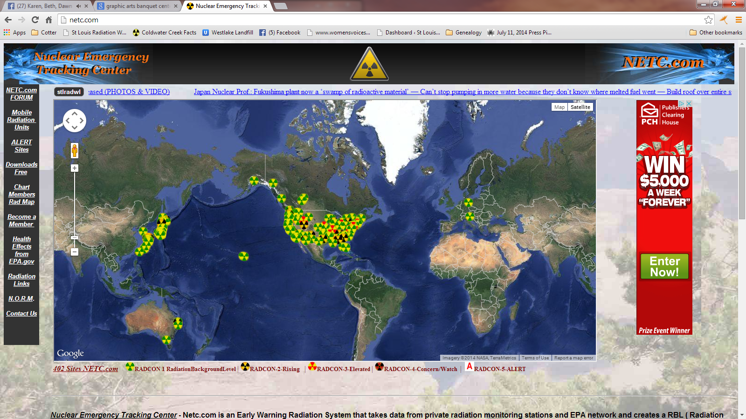
NETC.COM

Slide 33
What is NETC maps all about???
Hi all new bloggers
My name is Harlan and I design this Netc.com system, so let me help you understand the numbers. First of all, the system is design to tell when the radiation is increasing, not to tell you if it is bad or good. Only your Doctor know for sure. Second, Netc.com server calculates the NORM background radiation over a 3 month period, so when the alert message email is sent, the radiation is at least 10% higher than it was in the past 3 months. Third, do not compare one site with another because each site has different equipment, different locations, inside or outside and many other conditions. In the absolute mode in Japan, their sites around the Fuku NPP will always be in RADCON-5 compared to other sites. If the fuel rods break and the radiation going sky high, you will never know it because it is in Radcon-5. Netc.com does not use this method, it uses Relative mode where the NORM radiation level is created and compared to the current radiation level to create the Radcon levels.
Here is explanation on how to understand the NETC charts.
Some of the sites are from the EPA's database. The EPA's 4.site# are the beta sites from the EPA and the EPA's 5.site# are the gamma sites from 600-800 Kev range where a lot of Geiger counters are calibrated to. The sites in Japan uses nSw/h. Our system is based of relative readings from the past history of each site to their present readings, so you will be able to tell if there is an increase in radiation at that site. But some customers like to know what is the absolute level of radiation at each site, so with the chart membership you can change the readings to absolute base zero. The Japan maps looks totally different in absolute format. I am sorry that I have not posted this information in the Forum for you to understand what NETC.com system is all about. As a chart member, you can change the way Netc.com displays the data from Relative mode to Absolute mode, then you can see that Japan radiation level is much higher, but you will never know when the radiation increases because the Japan stations will always be in Radcon-5 level for the next 1000 years. In Relative mode the NORM background radiation at each station is compared to the current radiation level at that station, so when the radiation increases you can tell at your location that something has changed and alerts you of the increase radiation level. The degree of radiation increase determines the RADCON level that is set at your location. Netc.com does not compare one site location to another location because each location is different by the type of Geiger counter, inside or outside, location, etc.
The question about the Radcon-5 level, why is one location's level is 60 and another location's level is 500 for Radcon-5 Here is my answer:
“That is the questions that all the medical people and bloggers have been asking since the first Nuclear Bomb was dropped on Japan in 1945. I wish i could give you a simple answer, but I do not have one. I agree that an alert Radcom-5 in one location level is like 60 and in a different location the level is 500 for the Radcon-5, but one thing is in common in both locations - THE RADIATION HAS INCREASED, it is over the highest level in the last quarter of a year. It is easy to say, so what my level is only 60. That is correct, ask the Japanese people when their radiation was only 60, BEFORE MARCH 11, 2011. Netc.com is a warning service that tells you the radiation in your area is increasing, not if it is dangerous, let the experts argue that point. The radiation is coming, that is a given fact. The question is are you prepared.”
I hope this help. Harlan

Slide 34
www.netc.com ID: justmomsstl Pswd: fusrap
Nuclear Emergency Tracking Center - Netc.com is an Early Warning Radiation System that takes data from private radiation monitoring stations and EPA network and creates a RBL ( Radiation Background Level ) for each 3000+ stations everyday. NORM ( Natural Occurring Radioactive Material ) radiation background level has been simplified in name only to RBL ( Radiation Background Level ). The same calculations are still used. Radcon-1 will be the middle of RBL ( Radiation Background Level ) range and it will be compared to the Current Radiation at that monitoring station. The increase change between middle of RBL and the Current Radiation will set the Radcon levels 2 for small increase, 3 for higher increase, and 4 for the top of the range over a three month time frame. When RBL is above the radiation background range and other requirements are met, an Radcon-5 Alert will be issue and Email/Text messages are sent. If the Radcon-1 is Green/Yellow, the RBL (Radiation Background Level) is decreasing or staying the same level, like in Japan where most of the RBL are Green/Yellow.

Slide 35
NETC of St. Louis Metro

Slide 36
Information Showing the Community’s and EPA’s Monitors Online for One Month

Slide 37
Lois Gibbs – Love Canal

Slide 39
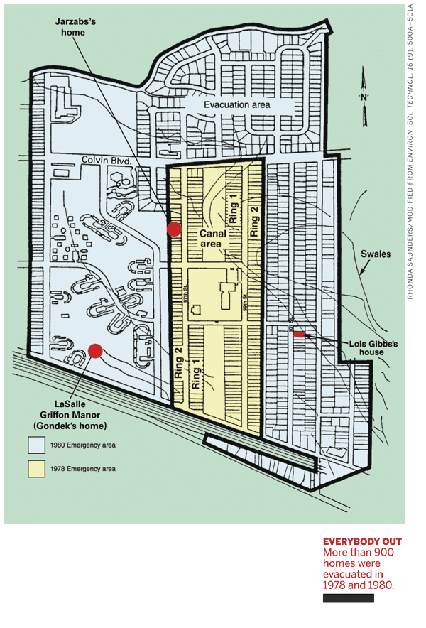
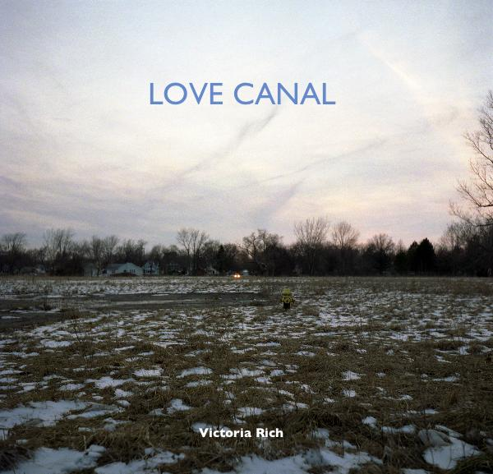
Video

Slide 40
-Save the Date -

Slide 41
County Health Researchers to look into Coldwater Creek cancer questions.
By Blythe Bernhard bbernhard@post-dispatch.com 314-340-8129
The St. Louis County health department plans to hire three researchers to study chronic disease and cancer rates among residents with a focus on the area surrounding Coldwater Creek, which was contaminated decades ago with nuclear waste.
Results from a survey organized by residents and released earlier this year showed 1,242 cancers among 3,300 people who had lived near the north St. Louis County creek, which runs from St. Ann to the Missouri River. The residents started the survey after noticing a spike in diseases among their classmates who graduated in the late 1980s and early 1990s from McCluer North High School in Florissant.
The residents’ work caught the attention of federal, state and local health officials, who attended community meetings on the topic.
“We need to be able to validate the information, to figure out if it is real and scientifically based, and whether we can get them more information and support,” said Dr. Dolores Gunn, the health department’s director.
A 2013 Missouri health department study found no higher risk of cancer for people living in ZIP codes surrounding the creek. The study’s authors acknowledged its limitations because their data included residents of the area from only 1996 to 2004.
“The Coldwater Creek contamination really had occurred decades before,” Gunn said. “The people who grew up there have migrated to other communities.”
http://www.stltoday.com/lifestyles/health-med-fit/health/county-health-researchers-to-look-into-coldwater-creek-cancer-questions/article_240ed090-355e-5e90-bd32-1496f42dabcd.html

Slide 42
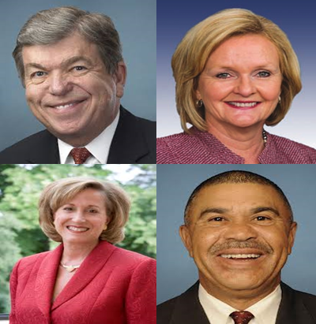

Slide 43
Sign Letter to Federally Elected Officials
Thank them for support St. Louis Army Corps of Engineers FUSRAP
Legislatively act to put St. Louis Army Corps of Engineers FUSRAP in charge at West Lake Landfill

Slide 45
Sign Letter to Governor Jay Nixon and Attorney General Chris Koster
Thanks Gov. Nixon for veto of Senate Bill 731
Thanks AG Koster for demanding offsite testing along haul routes & getting comprehensive air monitoring.
Please support St. Louis Army Corps of Engineers FUSRAP takeover of the West Lake Landfill

Slide 46
Sign Letter to EPA Region 7 Transparency Needed
Photo credit: St. Louis Public Radio

Slide 47
Upcoming Events
July 20th: 1–4 p.m. Open House, Pattonville Fire Department, 222 Maryland Heights Expressway, Maryland Heights, MO 63043 [across from Verizon Amphitheatre.
July 21st, 6:30pm: CAG Meeting at IUOE Local 513. – Subject - Preparedness Check the website for more information. http://www.westlakecag.org/
July 23rd, 10am: Prayer Vigil, North Side of Landfill, St. Charles Rock Road, FSM at former Phillips 66 gas station
Community Meeting at IUOE Local 513
will not be until September 18th due to Lois Gibbs meeting week of normal Community meeting
Thank You for Attending tonight’s meeting

